Slide 1

10-bit Custom Risc-V Microprocessor

Slide 2

1
2
3
Parsa Alam
Rian Ahmed
Md Ashraful
4
Abraham Kaikobad

Slide 3


PURPOSE
OBJECTIVE
Make a 10 bit custom Microprocessor
To solve particular arithmetic calculations
How to perform these instructions
To know how single cycle works

Slide 4
Instruction Type
R Type
Op code
rd
rs
rt
4 bit
2 bit
2 bit
2 bit

Slide 5
Instruction Type
I Type
Op code
rs
rt
Immediate
4 bit
2 bit
2 bit
2 bit

Slide 6
Instruction Type
J Type
Opcode
Target Address
4bit
6 bit

Slide 7
Operands
1
Register Based
2
Memory Based

Slide 8
OPERATIONS
Use 4 opcodes so that we can perform 16 operation
Data Transfer
logical
Arithmetic
Conditional Branch

Slide 9
OPERATION TABLE
Catagory | Operation | Name | Opcode | Type | Syntax | Comments
Arithmetic | Addition | add | 0010 | R | add $rd, $rs $rt | Three register operands
Arithmetic | Addition as Subtraction | sub | 0011 | R | sub $rd, $rs | Three register operands
Arithmetic | Addition immediate | addi | 1001 | I | addi $rs,$rt,const. | Used to add constants
Data Transfer | load word | lw | 1011 | I | lw $rd, offset | Load data from memory to register
Data Transfer | Store word | sw | 1100 | I | Sw offset($rd) | Load data from register to memory
Conditional | Branch on equal | beq | 1101 | I | beq $rd, offset | Check equality if else condition
Unconditional | Jump | Jmp | 1110 | j | Jmp offset | Jump to Given location

Slide 10
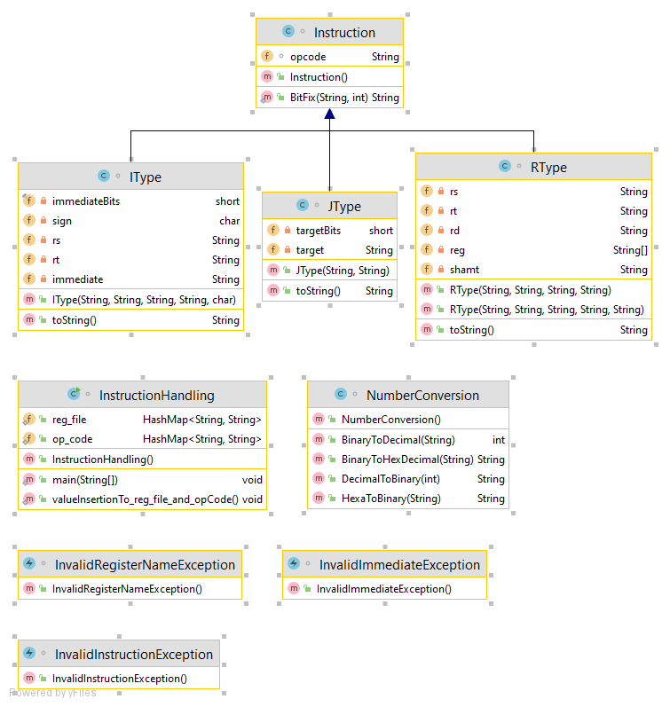
UML DIAGRAM-ASSEMBLER

Slide 11
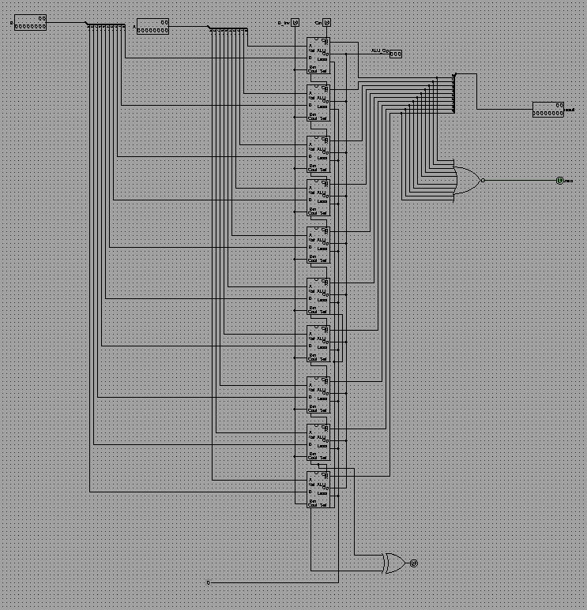
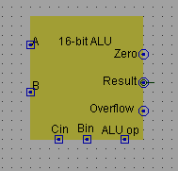
ALU

Slide 12
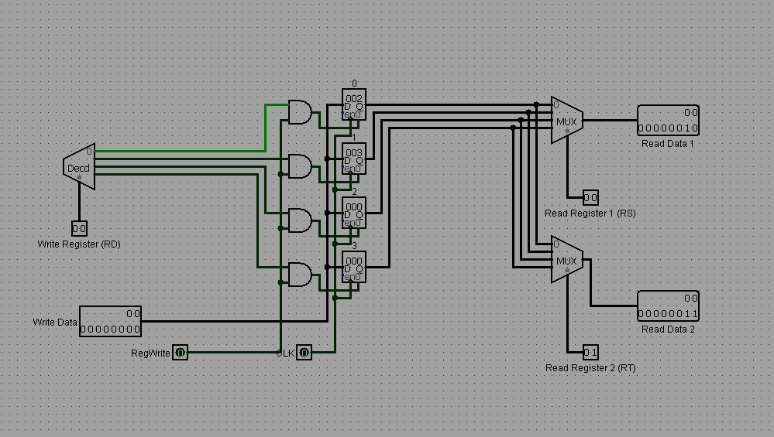
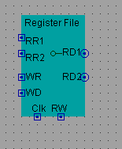
REG FILE

Slide 13
CONTROL UNIT TABLE
OPERATIONS | OPCODE | R/I TYPE | REG WRITE | ALU SRC | Cin | Binv | ALU op(6,7,8) | STORE | LOAD | MEM TO REG | JUMP
AND | 0000 | 0 | 1 | 0 | 0 | 0 | 000 | 0 | 0 | 0 | 0
OR | 0001 | 0 | 1 | 0 | 0 | 0 | 001 | 0 | 0 | 0 | 0
ADD | 0010 | 0 | 1 | 0 | 0 | 1 | 010 | 0 | 0 | 0 | 0
SUB | 0011 | 0 | 1 | 0 | 1 | 0 | 011 | 0 | 0 | 0 | 0
ADDi | 0100 | 1 | 1 | 1 | 1 | 1 | 100 | 0 | 0 | 0 | 0
SUBi | 0101 | 1 | 1 | 1 | 1 | 0 | 101 | 0 | 0 | 0 | 0
LW | 0110 | 1 | 1 | 0 | 0 | 0 | 110 | 0 | 1 | 1 | 0
SW | 0111 | 1 | 1 | 0 | 0 | 0 | 111 | 1 | 0 | 0 | 0

Slide 14
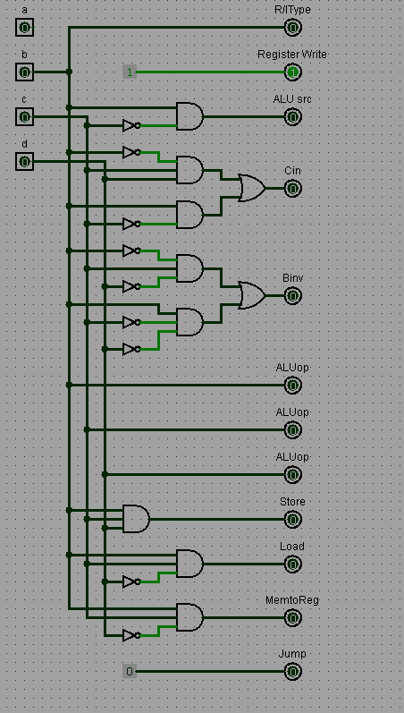
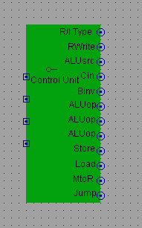
CONTROL UNIT

Slide 15
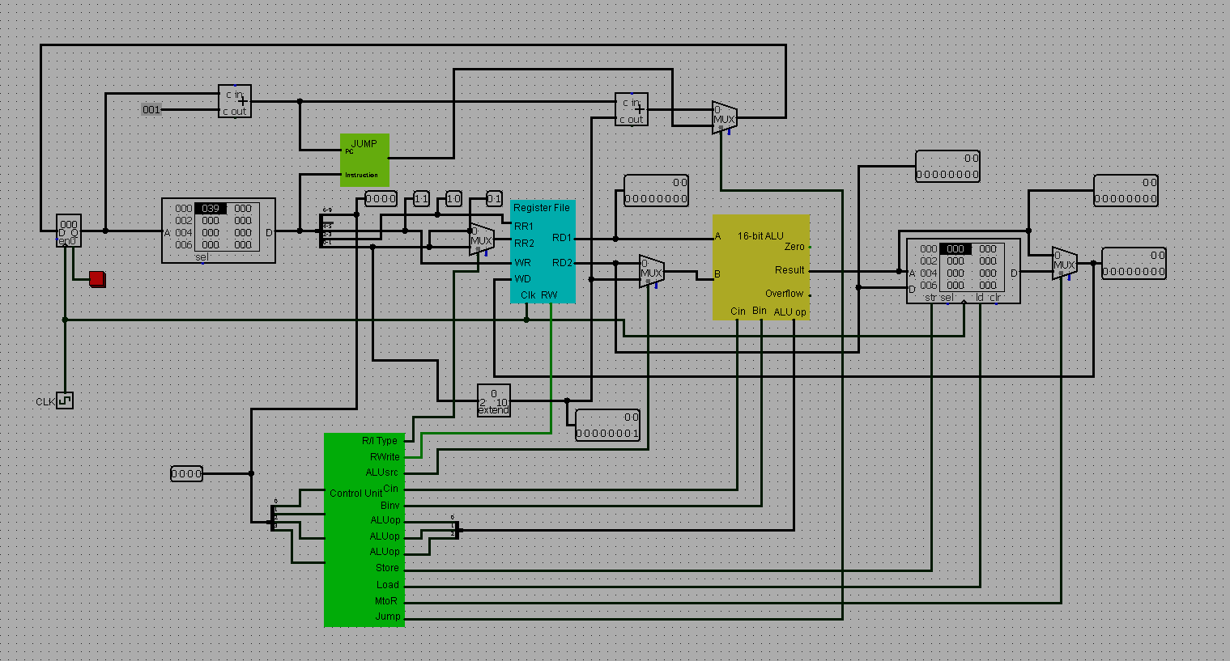
SINGLE CYCLE DATAPATH

Slide 16

THANK Y U
?
Question

